Slide 1
AURA
Assembly of university research administrators
November 9, 2021

Slide 2
AGENDa
New Staff Introductions T. Sagers
Updated Cost Transfers policy - HOOP 96 S. Gary
Accelerated/Delayed Spending S. Gary
FY2021 Audits - R&D and SEFA S. Gary
START - 2022 Training Sessions T. Sagers
START - Locating Project Status and Assignments T. Sagers
ECRT upgrade K. Vanzant
NIH Application Updates/Form Changes C. Martinez
Coverage Analyses K. Parks
CTA Budgets-START K. Parks
Q&A
Please mute and turn off cameras.

Slide 3
New staff introductions
Welcome!

Slide 4
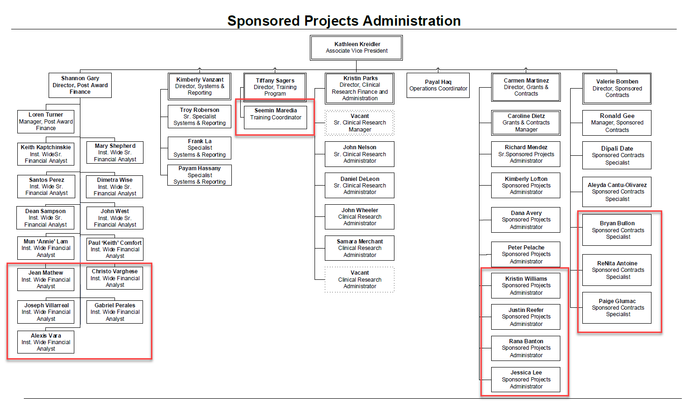

Slide 5
Updated cost transfers policy accelerated/delayed spending fy21 audits – R&D and sefa
Shannon Gary
Director, post award finance

Slide 6
Updated cost transfers policy – hoop 96
What is a Cost Transfer?
Moving a posted expense from one account to another after the expense was initially recorded and posted in the financial accounting system

Slide 7
Updated cost transfers policy – hoop 96
When is a Cost Transfer necessary?
To correct an error
To move or split costs into accounts that did not exist when the original transaction was made
For other reasons associated with a department’s fiscal operation
Transfers should be the exception,
NOT the rule

Slide 8
Updated cost transfers policy – hoop 96
Who is responsible for monitoring project costs?
Principal investigators and designated research faculty and staff are responsible for reviewing expenditures for allowability and allocability and to identify errors and omissions for resolution in a timely manner.
A high frequency of cost transfers implies
improper review and are highly scrutinized by auditors.

Slide 9
Updated cost transfers policy – hoop 96
All Cost Transfers must be:
Recorded in the General Ledger
Within 90 days from the close of the month when it was posted; or
Within 45 days after the end date of the award
Fully explained and justified
“To correct error” or “to transfer to correct project” is not acceptable.
Fully documented
Guidance is provided on the Cost Transfer form
Cannot cross fiscal years
Reason why the original charge was incorrect
Describe why the charge is allowable and allocable to the new project
Contain reference to the invoice, payroll, or other disbursement document(s) from the original charge

Slide 10
Updated cost transfers policy – Form & Website
Policy - https://www.uth.edu/hoop/policy.htm?id=1448040
SPA Main Website - https://www.uth.edu/sponsored-projects-administration/
Cost Transfer Request - https://www.uth.edu/sponsored-projects-administration/manage/cost-transfer-request
Cost Transfer Request Form - https://www.uth.edu/sponsored-projects-administration/tools-resources/tools-resources-documents/PAF_Cost_Transfer_%20Request_v1.pdf

Slide 11
Accelerated/delayed spending

Slide 12
Accelerated/delayed spending
NIH Grants Policy Statement:
April 2021
GMO monitors recipient expenditure rates by budget and overall project period
Funding is provided based on effort during the period
NIH expects the rate and types of expenditures to be consistent
GMO reviews cash drawdowns for patterns of accelerated or delayed spending
May indicate deficiency in recipient’s financial system or internal controls

Slide 13
Accelerated/delayed spending
WHAT SHOULD I WATCH FOR?
Does the purchase make sense and is it consistent with prior spending?
Purchases should not be made to “replenish supplies” and should be made to be used on project
Make sure items purchased are received and in use prior to the end of award
Follow guidance provided in closeout notifications for spending

Slide 14
Accelerated/delayed spending
Supplies were ordered on 6/28 for a project that ended 6/30. No supplies had been purchased on the project since it’s start one (1) year earlier. No extension was being requested, the scope of work was complete, and the appointment ended 6/30. DELAYED SPENDING
Lab supplies are purchased consistently every month for the first 10 months of the award at 5% of the budget. During the next month, it increases to 20%. ACCELERATED SPENDING
A second server was purchased during last month of awarded project period. Upon review of the award, it was noted that the anticipated award period would be for 5 years. The budget also stated that 2 servers would be purchased to assist with the data analysis needs. ALLOWABLE

Slide 15
FY21 audits – r&d and sefa
Research & Development (R&D)
Texas State Auditor’s Office
Selected to complete a R&D audit for FY21
Schedule of Expenditures of Federal Awards (SEFA)
Texas State Auditor’s Office
Selected to complete SEFA audit for FY21
Last audit was FY18
Auditors started field testing November 8
Auditors have submitted initial request for data and questions

Slide 16
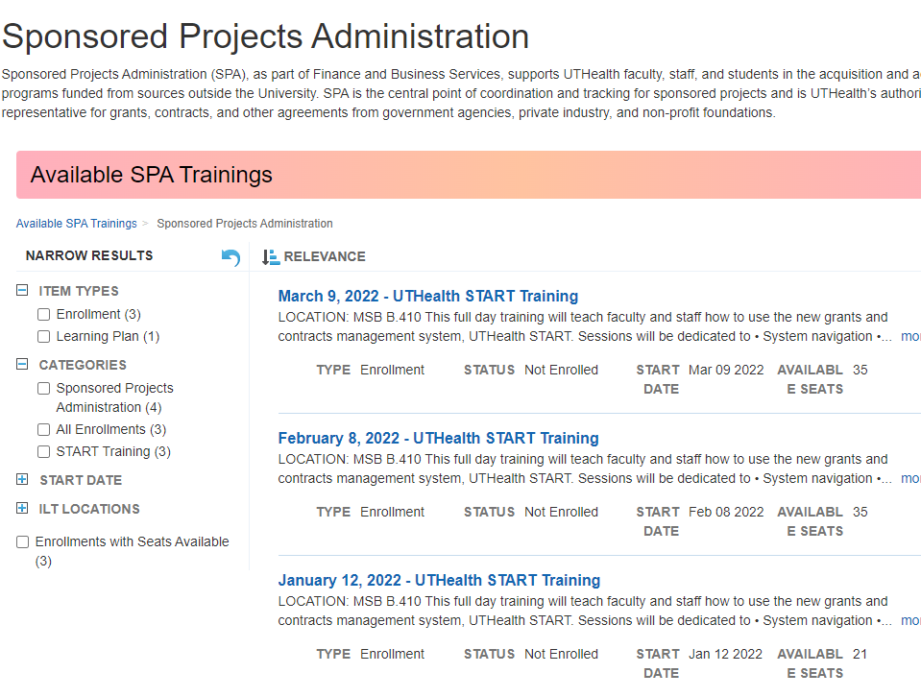
START - 2022 TRAINING SESSIONS
Locate in Learn2Succeed

Slide 17
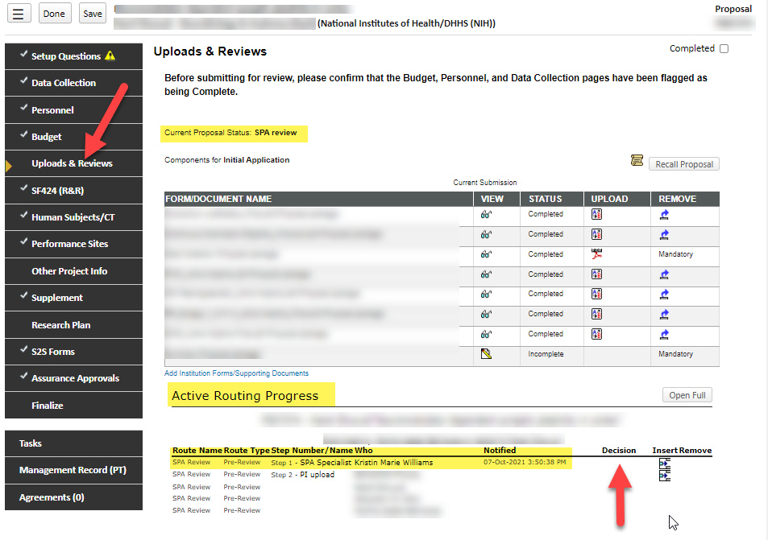
START – Project status and assignments
GRANT PROPOSALS
Locating the Status for Grant Proposals can be found by selecting the Uploads and Reviews tab.

Slide 18
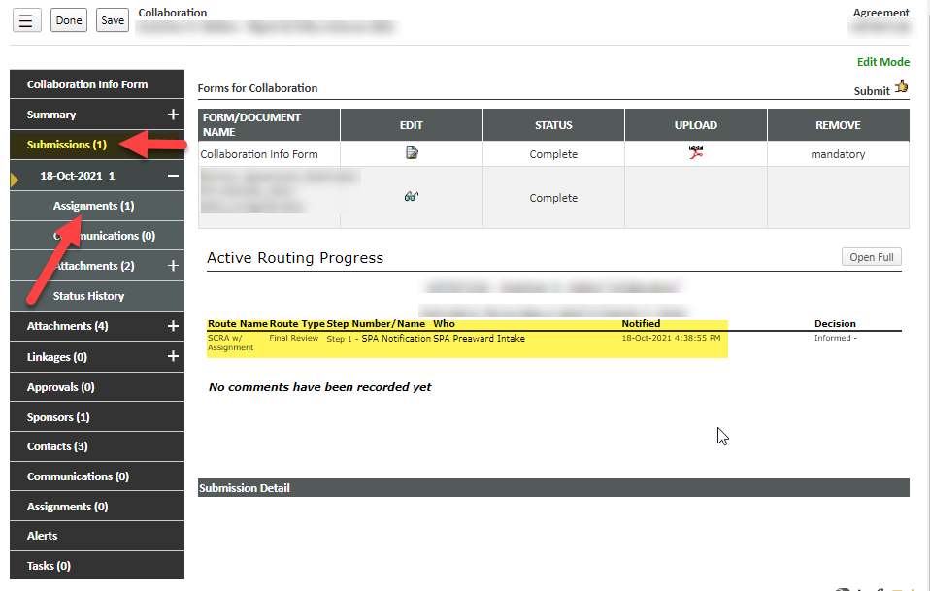
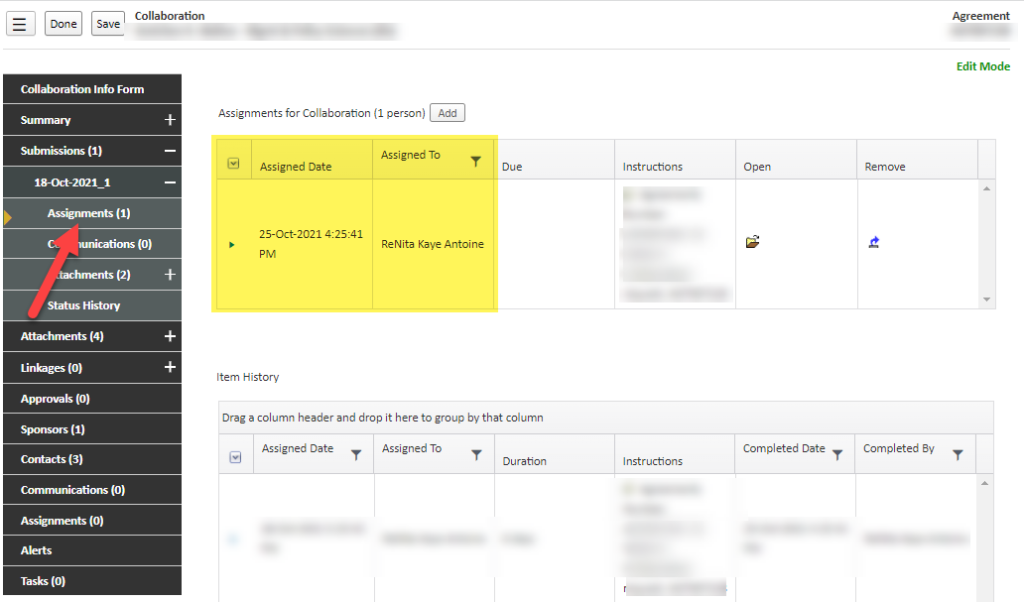
START – project status and assignments
Locating the status for an AGREEMENT can be found by selecting the assignments tab under the submission in the agreement's module.

Slide 19
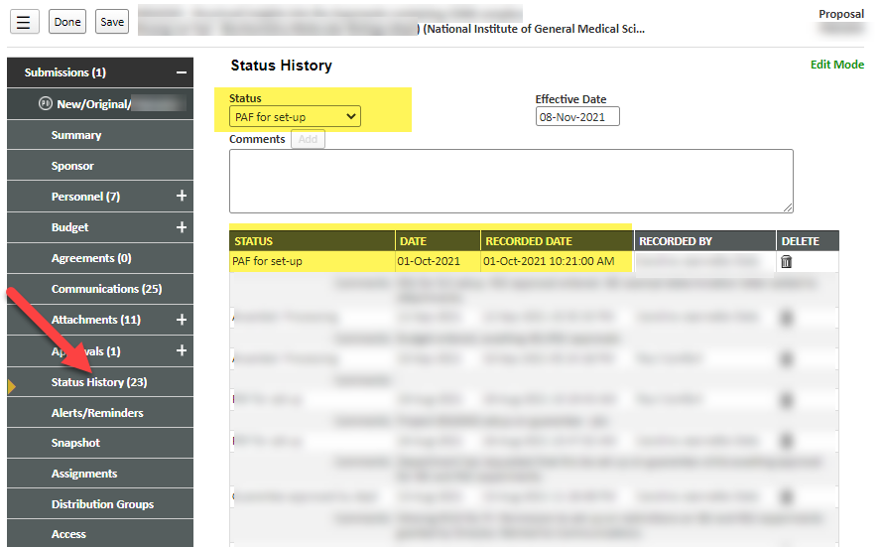
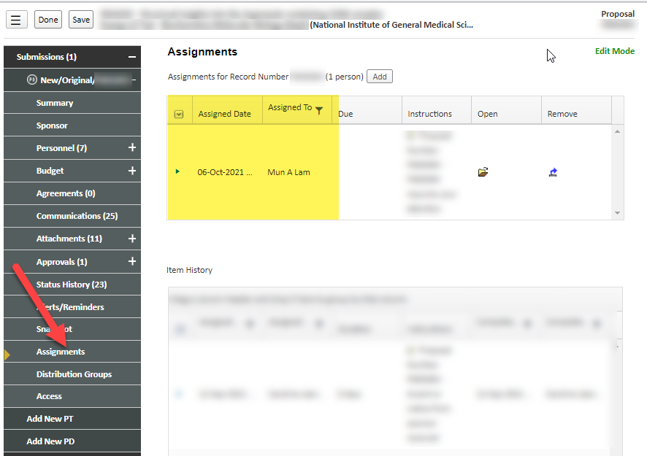
Start – project status and assignments
Locating the status of PAF SETUP can be found by selecting the assignments tab under the submission in the Sponsored Projects module.

Slide 20
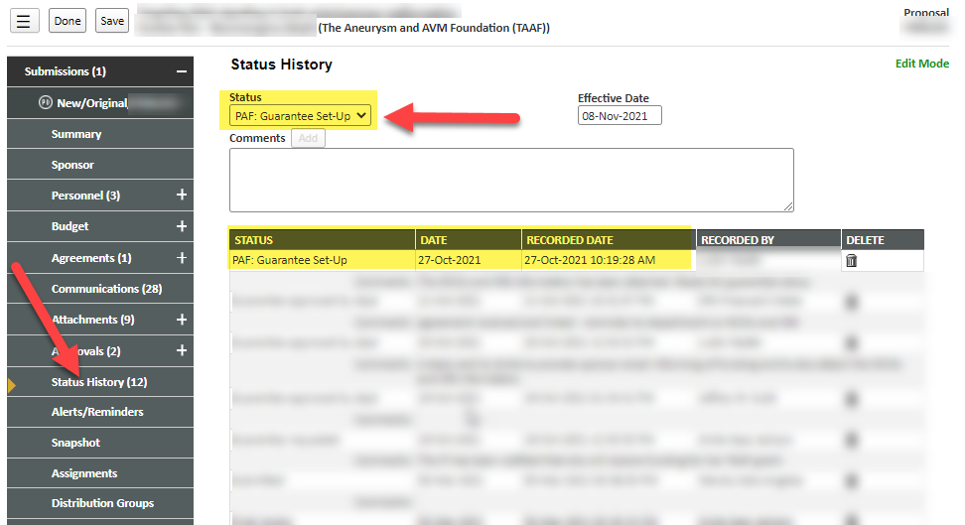
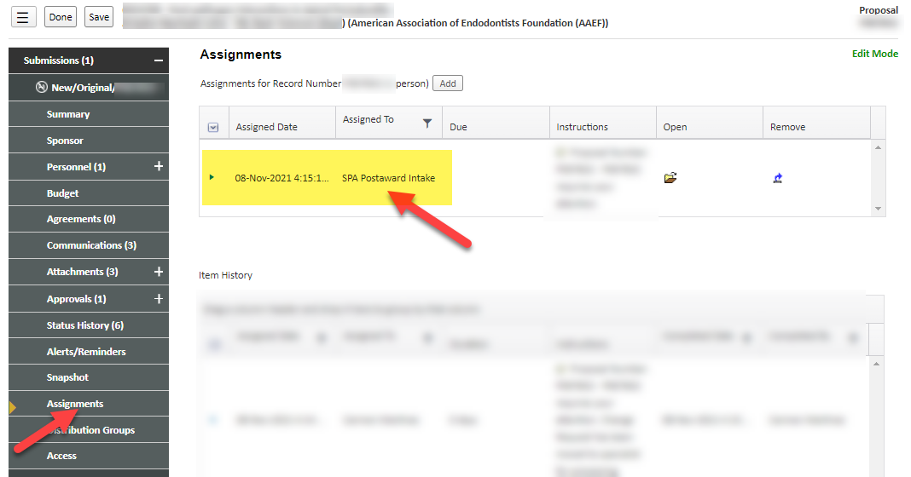

Slide 21
ECRT System Upgrade
ECRT upgrade:
UT Health is upgrading the Effort Reporting System (ECRT) to the most current version of the ECRT application now called Employee Compensation Compliance (ECC)
Go-Live is March 2021 with Certification for the July – February 2022 Period of Performance​
Main Enhancements are:
Project Statement certification (i.e. non-faculty and staff)
Improved Salary Cap functionality
Period of Performance will align with the Fiscal Year
Data Integration is being finalized
Review of HOOP Policy 93 begins November 5 2021

Slide 22
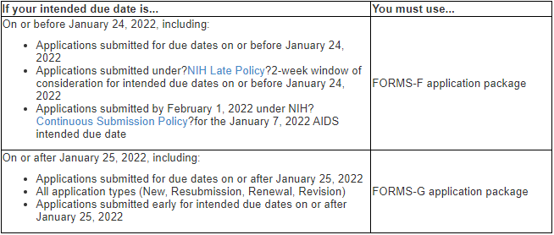
NIH Form Changes – effective January 25, 2022
New Forms G package implemented for all NIH/AHRQ applications submitted on/after Jan 25th, 2022
Updated forms meet revised agency standards. See NOT-OD-22-018.
Review detailed updates at https://grants.nih.gov/grants/electronicreceipt/files/high-level-form-change-summary-FORMS-G.pdf

Slide 23
NIH Biosketch Updates
NOT-OD-21-073 for guidance
Section B. ‘Positions and Honors’ has been renamed, ‘Positions, Scientific Appointments and Honors.’
List all current positions and scientific appointments, both domestic and foreign.
Includes titled academic, professional or institutional appointments
Must be listed in reverse chronological order
If all required information is not included, the Biosketch is incomplete

Slide 24
NIH Biosketch updates - cont
Section D now only includes Scholastic Performance, and is only required predoctoral and postdoctoral fellowships
Candidates for research supplements to promote diversity in health-related research from the undergraduate through post-doctoral levels.
As applicable, all applicants may include details on ongoing and completed research projects from the past three years that they want to draw attention to within the personal statement, Section A.
The 5-page limit for Biosketch has not changed

Slide 25
Other Support Updates
To support the need for full transparency, NIH has updated forms and instructions to capture all sources of research support
All projects currently under consideration from whatever source, and all ongoing projects, irrespective of whether support is provided through the proposing organization, another organization or directly to the individual, and regardless of whether or not they have monetary value must be listed
in-kind such as office/laboratory space, equipment, supplies, or employees
Consulting agreements for research activity
Paid travel
Supporting documentation required for foreign activity
Translated copies of contracts, grants or other agreements must be provided

Slide 26
NIH Other Support Updates
Re-organized to separate funded projects from in-kind contributions
Signature block added to certify the accuracy of the information submitted
Electronic signature only!

Slide 27
Coverage analysis
UTHealth contracted with Huron Consulting Group to complete coverage analyses. (Effective: 01/01/2021)
Industry sponsored/initiated clinical studies- Departments must budget accordingly
Non-Industry Initiated Clinical Studies-SPA will cover costs-
Notes:
Fees will be charged to studies via journal entry
Fee will be split between direct and indirect costs

Slide 28
Coverage analysis
Benefits
- Workload shift from study staff and SPA to Huron
-Decreased turnaround time
-Strengthened Research Billing Compliance

Slide 29
Coverage analysis
Tracking in START
- START AGT record for CA’s are built by CRFA team in SPA
-“CA assigned to Huron” is a status in START
-When returned from Huron record is noted as “CA –Approved” or “CA- Approved- Epic

Slide 30
Coverage analysis

Slide 31
Coverage analysis
“Coverage Analysis Internal Budget “ Tool
CAIB excel tool serves two purposes
1. Coverage Analysis
CA AGT Record in START
2. Internal Budget
Proposal Record in START

Slide 32
CTA budget review and approval
CTAs are submitted to SPA for budget review and financial congruency check prior to execution of the CTA agreement.
- Final CA-budget grid must be attached to the PD record
- Budget entered into PD record must match the CA budget grid (total estimated revenue)
DMOs/Dept Managers should be reviewing these items before approving:
Is it complete?
Is it accurate?
Is it realistic?

Slide 33
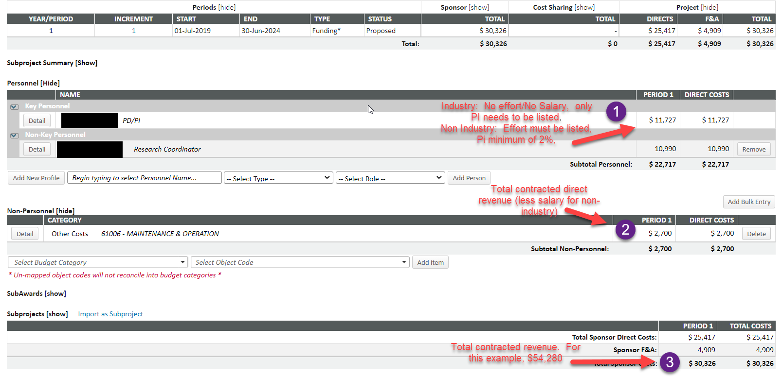
CTA budget review and approval

Slide 34
Coverage analysis outsourcing fees
Initial – Industry
 | Direct | Indirect | Total
Low Complexity | $ 1,100 | $ 330 | $ 1,430
Medium Complexity | $ 2,200 | $ 660 | $ 2,860
High Complexity | $ 2,800 | $ 840 | $ 3,640
Amendments – Industry
Low Complexity | $ 600 | $ 180 | $ 780
Medium Complexity | $ 800 | $ 240 | $ 1,040
High Complexity | $ 1,000 | $ 300 | $ 1,300

Slide 35
Coverage analysis outsourcing fees
Study Complexity Level | General Characteristics
Low | PI-Initiated or industry-sponsored simple study. Items tend to be paid by the sponsor and the schedule of events in the protocol has very few items. Low complexity studies may simply involve biospecimen samples and office visits
Medium | Largest complexity group for clinical trials. PI-Initiated or industry sponsored study. Items will be both sponsor paid and conventional care. The schedule of events in the protocol will contain several items but is usually limited to one arm.
High | Typically, high complexity studies are industry or federal sponsored clinical trial. These studies have a high number of conventional care procedures. They may involve multiple cancers, multiple arms, and cutting-edge treatment such as stem cell therapy.
Medium complexity is the most common

